Slide 1
Collective Visioning, SPT, and Hyperstitional Disruption in Organizations
Adam Cowart
December 15, 2017

Slide 2
What is Presencing?
Definition
“Theory U has come to be understood in three primary ways: first, as a framework; second, as a method for leading profound change; and third, as a way of being.”
“Presencing is about rooting down into the present, where the future already exists.”
Self awareness – not only of self but your emerging, potential self

Slide 3
Profound Need for Change
Generative Processes

Slide 4
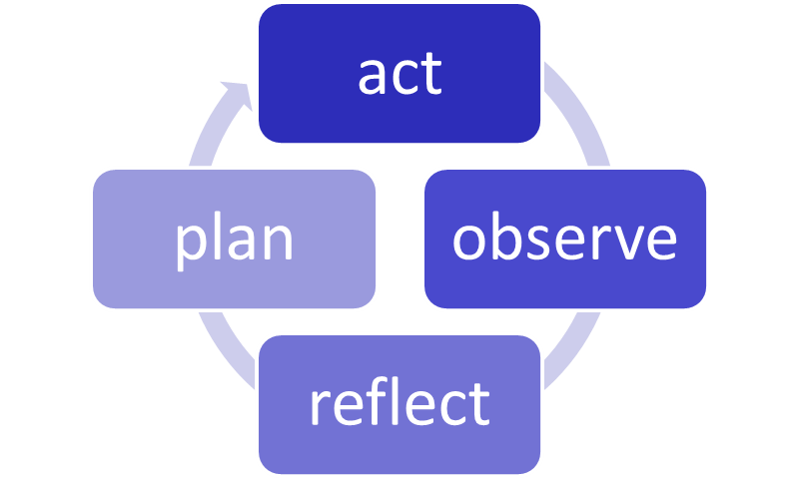
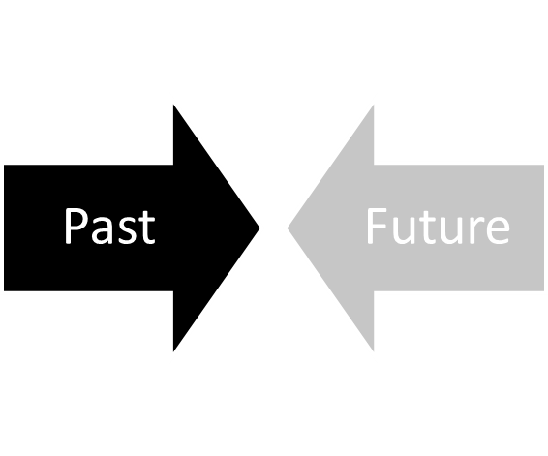
Two Models of Learning
Cycles
Learning by reflecting on the experiences of the past
B. Learning (and acting) from the future as it emerges (presencing)

Slide 5
The Journey
Theory U
Downloading past patterns
Performing by operating from the whole
Open
Mind
VoJ
suspending
embodying
Seeing with fresh eyes
Prototyping the new by linking head, heart, hand
Open
Heart
VoC
redirecting
enacting
Sensing from the field
Crystallizing vision and intention
Open
Will
VoF
letting go
letting come
Presencing connecting to Source

Slide 6
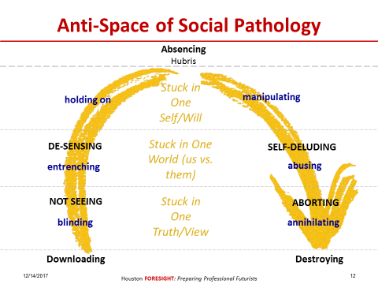
Pathology of Absencing
Anti-Journey

Slide 7
Core Process
Translating Theory U to Multiplicity
Old Language
New Language
Old Frustrations
New Opportunities
Old Images
New Images

Slide 8
Fragmentation of Dominant Narrative
Common Ground of the Past, Current State, (Shared) Future Images

Slide 9
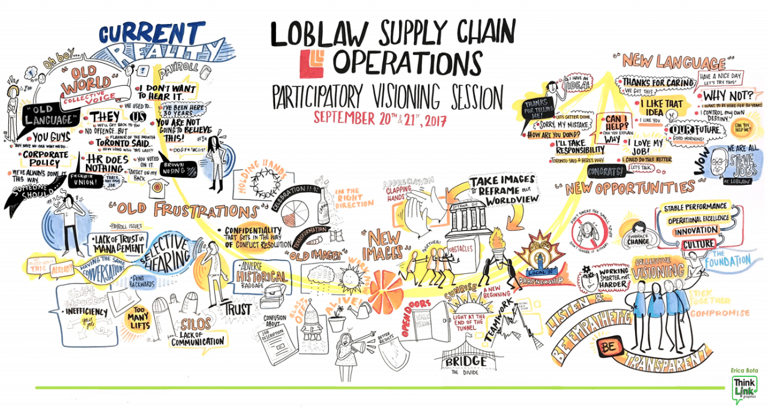

Slide 10
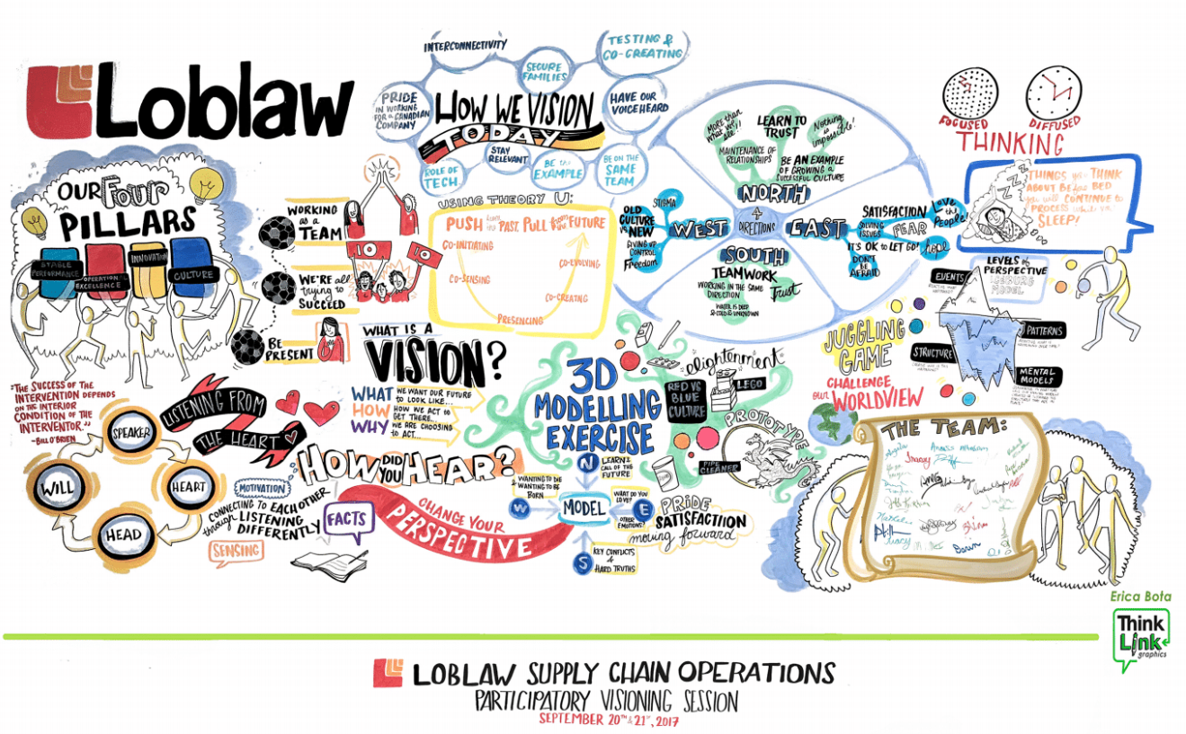

Slide 11
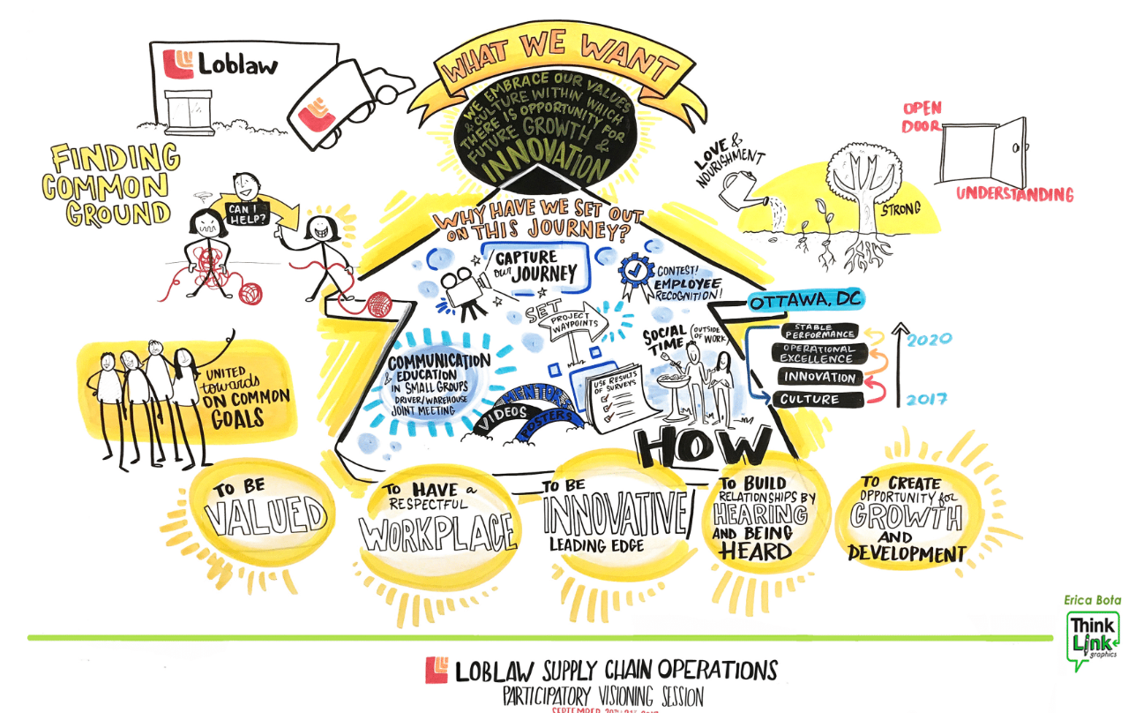

Slide 13
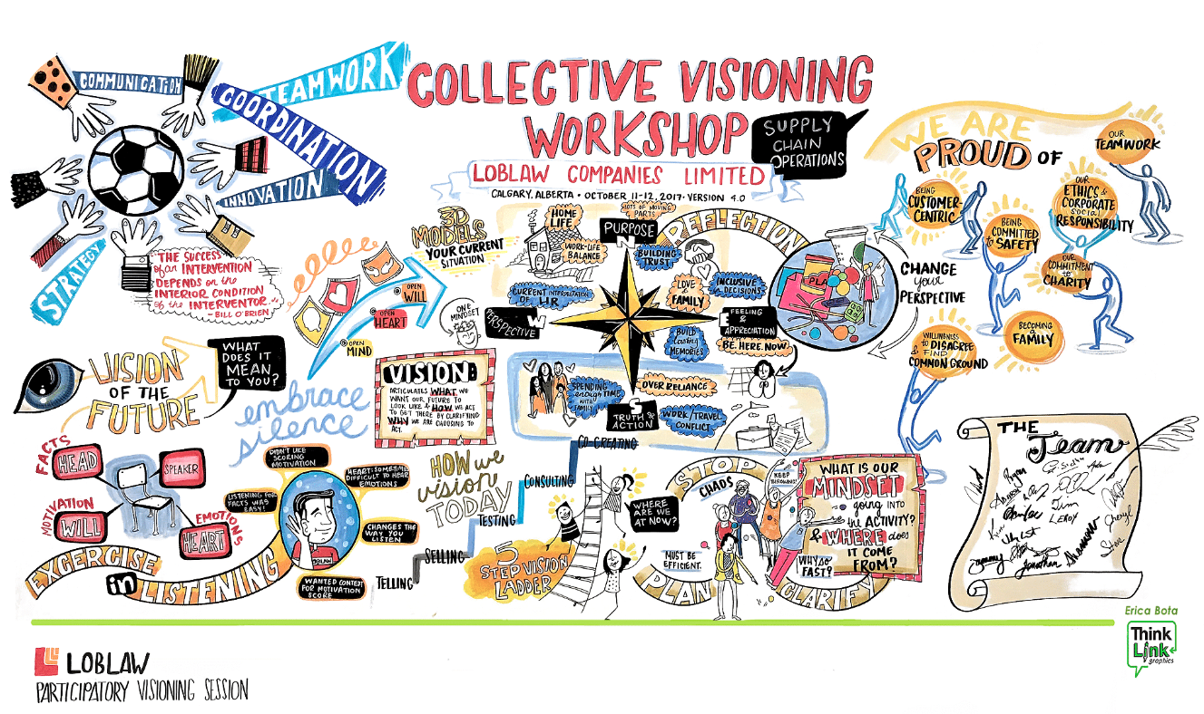

Slide 15
Vision Fluency: Critical Framework
Notes:
Situating are Vision. Are we happy with the level of Optimism and Agency?

Slide 16
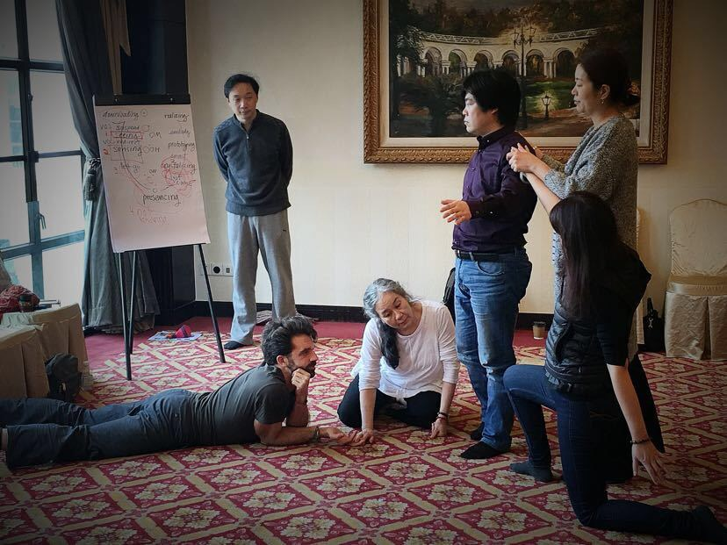
Social Presencing Theatre
Body-based learning for sensing and articulating the current reality and “exploring emerging future possibilities”.

Slide 17
SPT Exercises
10 Minutes Dance
Lie on the floor. Over the course of 10 minutes, move to a standing position, letting your body dictate movement.
NOT your brain
The Village
1st Iteration: Walk or “run” (no backwards) through space
2nd Iteration: Allow sitting
3rd Iteration: Acknowledgement of others – make eye contact, pause, bow, eye meet again, move on

Slide 18
SPT Exercises
“Stuck” Individual
Think of where personally or professionally you are “stuck”
Allow your body to take on a shape/posture that embodies this “stuck”.
Clarify
Create posture 2 for “unstuck”
Clarify
Allow body to discover the path from gesture 1 to gesture 2
“Stuck” Group Exercise
Follow all steps of “Stuck” Individual exercise
For gesture 1, position others in group around you, to create a group “stuck” sculpture
Clarify gesture, then allow body to trigger movement, ultimately ending in gesture 2
Once complete, allow moment of clarity, then each person in group says the first word that comes to mind (“stuck” goes last)

Slide 19
SPT “Stuck System” Mapping Exercise
Whole System Dance
Name the “Players” in the System – Name Tags for each player
One at a time, a player enters and explores space before taking a position and a posture/gesture
Once all players have chosen their position, there is a moment of collective clarification
Then “dance” begins
Movement continues for several minutes until each “Player” reaches a final resting space
Each player then says one word – whatever comes into mind first

Slide 20
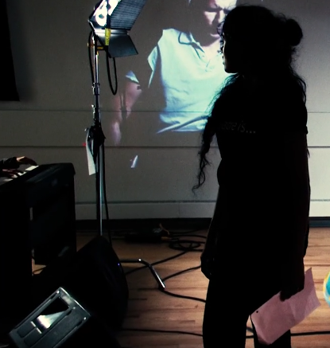
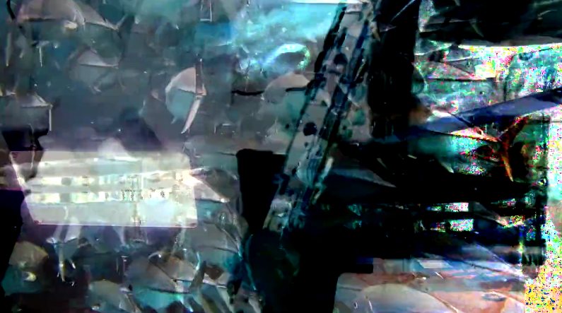
Algorithmyth/Entangled
Impact Festival 2017

Slide 21
Centre for Quantum Computing
University of Waterloo

Slide 22
Causal Layer Analysis
Sohail Inayatullah
Events
Patterns
Structure
Mental Models (Worldview)
Myths/Organizing Metaphors

Slide 23
Connecting Across Space and Time
Quantum Entanglement
Particles interacting in such a way that the quantum state of each particle cannot be described independently of each other
“Spooky action at a distance” Einstein
Clockwise
Clockwise
Counter
Counter

Slide 24
Across Space
Organizational Sensemaking, Quantum Storytelling and Innovation - Tamaraland

Slide 25
Hyperstitional Processes
Fiction to Reality
“Hypersititions by their very existence as ideas function causally to bring about their own reality… transmuting fictions into truths.” Nick Land

Slide 26
Transmutations Across Time
Hyperstitional Disruptions Across Time: Past Present and Future Time in Innovation Ideation and Hauntology

Slide 27
From Tamaraland to Hauntological House
Living Story or Undead???

